Slide 1
FOURIER ANALYSIS OF NUMERICAL INTEGRATION IN MONTE CARLO RENDERING
Kartic Subr Gurprit Singh Wojciech Jarosz
Heriot Watt University Dartmouth College Dartmouth College

Slide 2
This course …

Slide 3
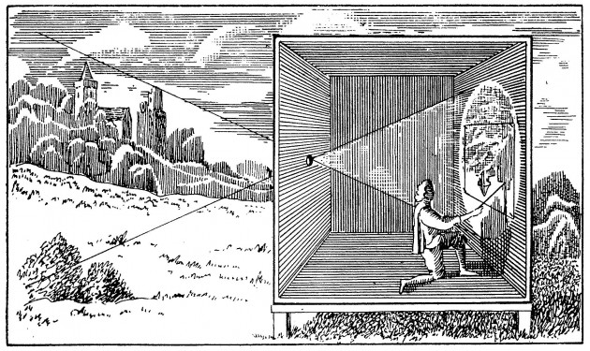
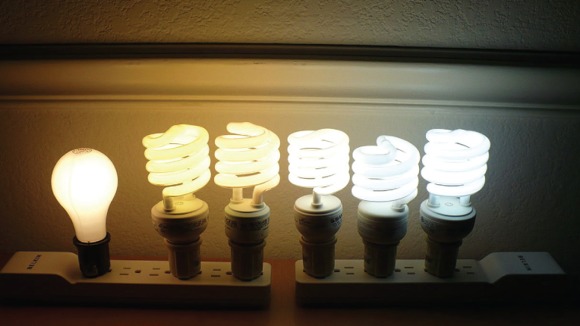
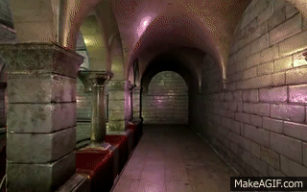
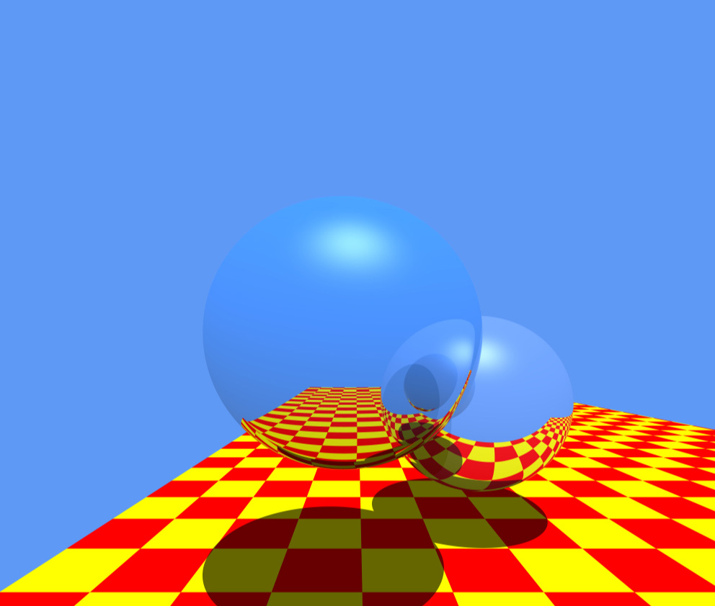
Rendering = geometry + radiometry
geometry/projection
for pin-hole model known since 400BC
radiometrically accurate simulation
is important for photorealism
OpenGL
Raytracing
[Stachowiak 2010]
[Whitted 1980]
camera obscura
[photo credit: videomaker.com June 2015]

Slide 4
Rendering = geometry + radiometry
geometry/projection
for pin-hole model known since 400BC
radiometrically accurate simulation
is important for photorealism
OpenGL
Raytracing
[Stachowiak 2010]
[Whitted 1980]
[photo credit: videomaker.com June 2015]

Slide 5
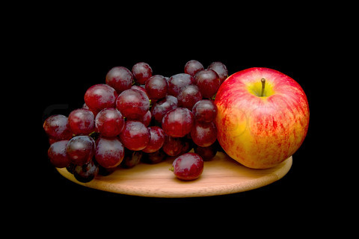
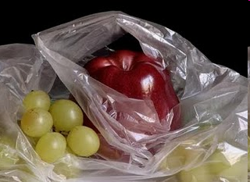

Radiometric fidelity improves photorealism
photograph
manually painted
computer generated
Colourbox.com
Pedro Campos

Slide 6

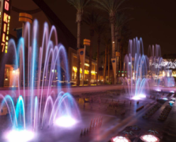
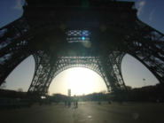

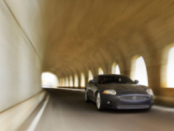
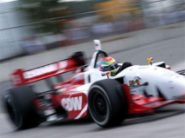
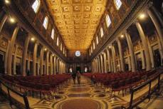
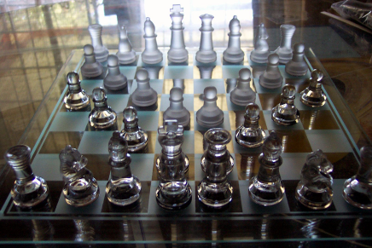
Simulating the physics of light is challenging
defocus
exposure time
lenses
light, media
materials

Slide 7
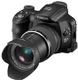
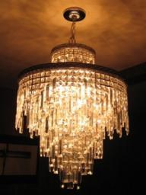
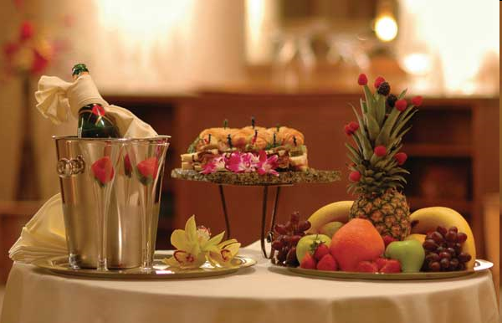
Light transport
virtual
light emitter
virtual
camera
Image ?
virtual scene: geometry + materials
estimate incident radiance at all pixels
on the virtual sensor
exitant radiance
W
m² Sr

Slide 8






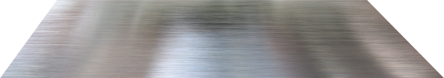

Each reflection is modelled by an integration
radiance:

Slide 9
Each reflection is modelled by an integration
radiance:

Slide 10
Each reflection is modelled by an integration
radiance:

Slide 11
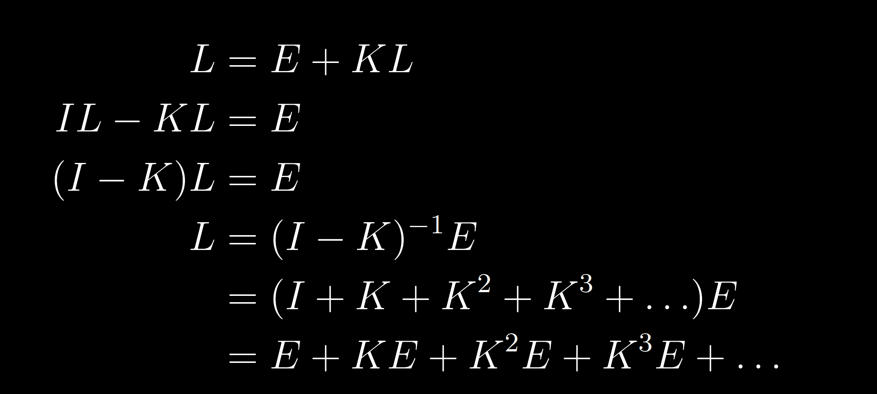
Light transport: recursive integral equation
radiance
emitted radiance
integral operator
The Rendering equation [Kajiya 86]
Light Transport Operators [Arvo 94]

Slide 12
L is a sum of high-dimensional integrals
radiance
integral operator
emitted radiance
One bounce
Three bounces

Slide 13
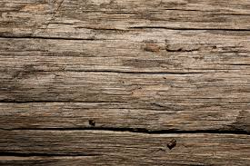

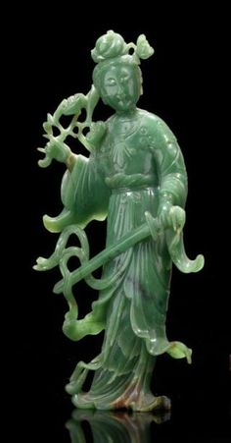
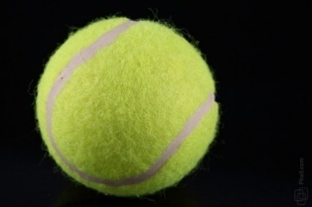
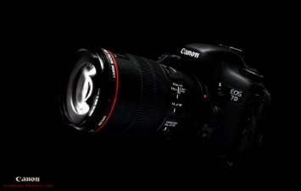
Function-space view: Sampling in path space
each sample represents a path
and has an associated radiance value
light
light paths
camera
n-dimensional path space
Notes:
3 trillion paths and 16D

Slide 14
Sample locations shown in path-pixel space
n-dimensional path space
pixels on sensor
Notes:
Figure from SIGG course notes

Slide 15
Rendering: integration followed by reconstruction
path-space integration
(projection)
n-dimensional path space
pixel value (radiance)
reconstruction using
integrated radiance
pixels on sensor
pixels on sensor
Notes:
Figure from SIGG course notes

Slide 16
Reconstruction

Slide 18
Local variation is useful for adaptive sampling
path-space integration
(projection)
pixel value (radiance)
n-dimensional path space
integrated radiance
local variation/
anisotropy?
use in regression/reconstruction
pixels on sensor
pixels on sensor
Notes:
Figure from SIGG course notes

